Slide 1
Your Fu is Better Than Mine BoF
NetDev 0x19
PJ Waskiewicz, Linux Kernel Engineer
March 12th, 2025
Zagreb, Croatia

Slide 2
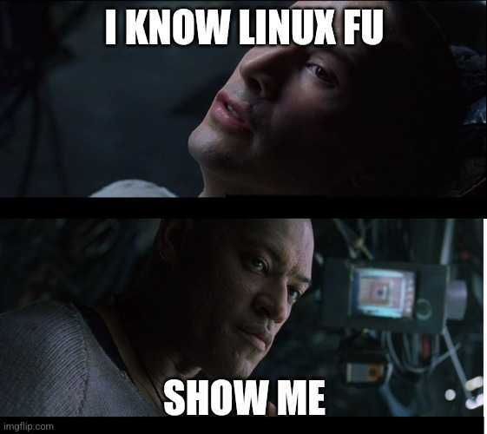

Slide 3
Out-of-tree module juggling
Who writes/maintains out-of-tree modules or drivers?
Who lives in a distro-driven world?

Slide 4

Distro kernel purgatory
ABI never changes inside distro kernels

Slide 5
Distro kernel purgatory
Bull!@#$# ... ABI changes…sort of
struct ethtool_ops {
[...]
RH_KABI_REPLACE(int (*get_coalesce)(struct net_device *,
struct ethtool_coalesce *),
int (*get_coalesce)(struct net_device *,
struct ethtool_coalesce *,
struct kernel_ethtool_coalesce *,
struct netlink_ext_ack *))

Slide 6
Diff, patch, and tag
# git tag
v4.18-rc5
v4.18-rc6
v4.18-rc7
v4.18-rc8
v4.18.0-240.10.1.el8_3
v4.18.0-348.23.1.el8_5
v4.18.0-348.el8
v4.18.0-372.32.1.el8_6
v4.18.0-477.36.1.el8_8
v4.19

Slide 7
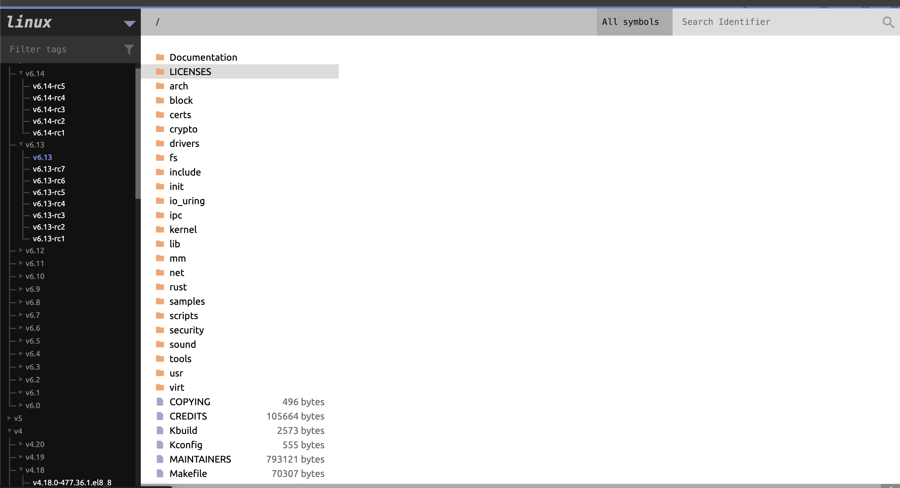
Elixirs and potions to the rescue
https://github.com/bootlin/elixir

